Slide 1
Introduction to MongoDB
Notes:
10s

Slide 2
Content
Overview
SQL vs MongoDB
MongoDB Data Model
Installation
MongoDB Queries
Questions
Notes:
30s

Slide 3
Overview
In one day:
24 million transactions processed by Walmart
100 TB of data uploaded to Facebook
175 million tweets on Twitter
……….
How to store, query and process these data efficiently?
Notes:
30s

Slide 4
Overview
The problems with Relational Database:
Overhead for complex select, update, delete operations
Select: Joining too many tables to create a huge size table.
Update: Each update affects many other tables.
Delete: Must guarantee the consistency of data.
Not well-supported the mix of unstructured data.
Not well-scaling with very large size of data.
NoSQL is a good solution to deal with these problems.
Notes:
https://infocus.emc.com/april_reeve/big-data-and-nosql-the-problem-with-relational-databases/
1min

Slide 5
Overview
What is NoSQL:
NoSQL = Non SQL or Not only SQL
Wikipedia’s definition:
A NoSQL database provides a mechanism for storage and retrieval of data that is modeled in means other than the tabular relations used in relational databases.

Slide 6
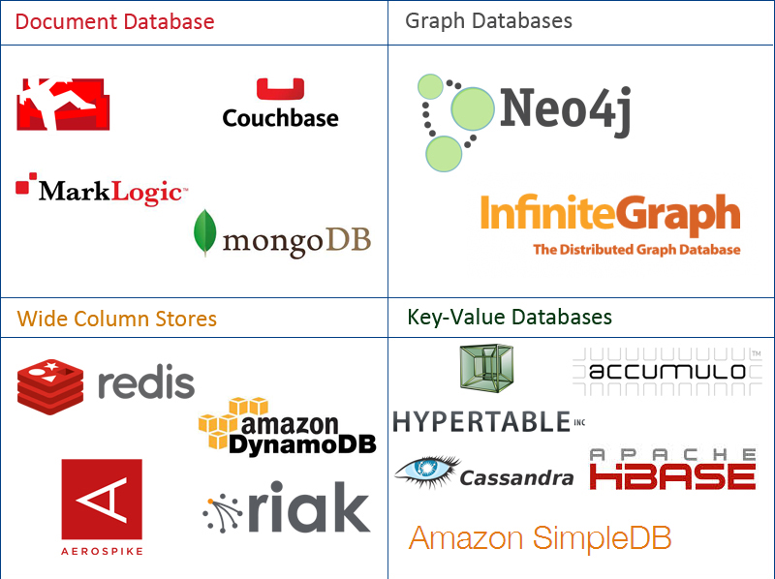
Overview – NoSQL Family
Data stored in 4 types:
Document
Graph
Key-value
Wide-column
Notes:
https://www.mongodb.com/nosql-explained http://aryannava.com/2014/04/06/nosql-databases-family/

Slide 7
Overview – MongoDB
MongoDB is:
An open source and document-oriented database.
Data is stored in JSON-like documents.
Designed with both scalability and developer agility.
Dynamic schemas.
Notes:
What is dynamic schemas?

Slide 8
SQL vs MongoDB
SQL Terms/Concepts | MongoDB Terms/Concepts
database | database
table | collection
row | document
column | field
index | index
table joins (e.g. select queries) | embedded documents and linking
Primary keys | _id field is always the primary key
Aggregation (e.g. group by) | aggregation pipeline
Notes:
What is the index in MongoDB
Embedded documents and linking??
Aggregation pipeline??
http://docs.mongodb.org/manual/core/data-model-design/

Slide 9
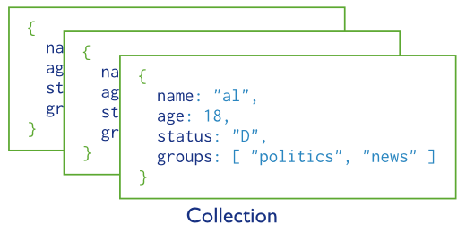
MongoDB Data Model
A collection includes documents.
Notes:
The schema is very flexible. Documents in each collection can have different structures.

Slide 10
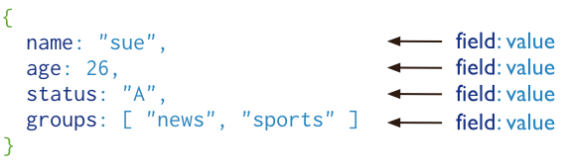
MongoDB Data Model
Structure of a JSON-document:
The value of field:
Native data types
Arrays
Other documents
Notes:
The schema is very flexible. Documents in each collection can have different structures.

Slide 11
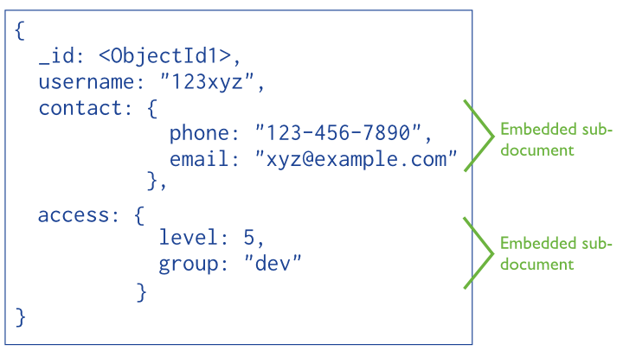
MongoDB Data Model
Embedded documents:
The primary key
Notes:
With embedded documents, we do not need complicated join table.
Why objectId1 – a hex string

Slide 12
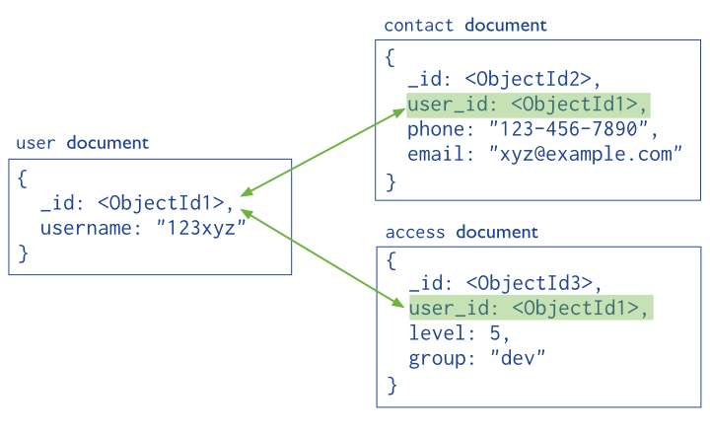
MongoDB Data Model
Reference documents or linking documents
Notes:
With embedded documents, we do not need complicated join table.
Why objectId1 – a hex string

Slide 13
Installation
Download and install suitable package for each platform https://www.mongodb.com/download-center?ct=false#atlas
Create a folder e.g. C:\mongo
Go to bin of installation folder.
Type following command: mongod --dbpath=C:/mongo
Run another command: mongo.exe
The mongodb server is running.

Slide 14
MongoDB Queries:
CRUD (Create – Update – Delete)
Create a database: use database_name
Create a collection: db.createCollection(name, options)
options: specify the number of documents in a collection etc.
Insert a document:
db.<collection_name>.insert({“name”: “nguyen”, “age”: 24, “gender”: “male”})
Query [e.g. select all]
db.<collection_name>.find().pretty()
Query with conditions:
db.<collection_name>.find( { “gender”: “female”, “age”: {$lte:20} }).pretty()

Slide 15
MongoDB Queries:
CRUD (Create – Update – Delete)
db.<collection_name>.update(<select_criteria>,<updated_data>)
db.students.update({‘name':‘nguyen'}, { $set:{‘age': 20 } } )
Replace the existing document with new one: save method:
db.students.save({_id:ObjectId(‘string_id’), “name”: “ben”, “age”: 23, “gender”: “male”}

Slide 16
MongoDB Queries:
CRUD (Create – Update – Delete)
Drop a database
Show database: show dbs
Use a database: use <db_name>
Drop it: db.dropDatabase()
Drop a collection:
db.<collection_name>.drop()
Delete a document:
db.<collection_name>.remove({“gender”: “male” })

Slide 17
Questions?

